Slide 1

AI Searching Techniques
Introduction to Artificial Intelligence
Dr. Saif Ur Rehman

Slide 2
Today’s Lecture
Problem-solving agents
Problem types
Problem formulation
Example problems
Basic search algorithms

Slide 3
Motivations
One of the major goals of AI is to help humans in solving complex tasks
How can I fill my container with pallets?
Which is the shortest way from Lahore to Islamabad?
Which is the fastest way from Lahore to Islamabad?
How can I optimize the load of my freight to maximize my revenue?
How can I solve my Sudoku game?
What is the sequence of actions I should apply to win a game?

Slide 4
Motivations
Sometimes finding a solution is not enough, you want the optimal solution according to some “cost” criteria
All the example presented in previous slide involve looking for a plan
A plan that can be defined as the set of operations to be performed of an initial state, to reach a final state that is considered the goal state
Thus we need efficient techniques to search for paths, or sequences of actions, that can enable us to reach the goal state, i.e. to find a plan
Such techniques are commonly called Search Techniques

Slide 5
Problem Solving in AI
In today’s fast-paced digitized world, artificial intelligence techniques are used widely to automate systems that can use the resource and time efficiently.
Some of the well-known problems experienced in everyday life are games and puzzles.
Using AI techniques, we can solve these problems efficiently

Slide 6
Problem Solving in AI
Some of the most common problems resolved by AI are
Travelling Salesman Problem
Tower of Hanoi Problem
Water-Jug Problem
N-Queen Problem
Chess
Sudoku
Crypt-arithmetic Problems
Magic Squares
Logical Puzzles and so on.

Slide 7
Problem Solving Techniques
In artificial intelligence, problems can be solved by using
Searching algorithms
Evolutionary computations
Knowledge representations, etc.
Various searching techniques that are used to solve a problem.
In general, searching is referred to as finding information one needs.

Slide 8
Search Algorithms in AI
In computer science, problem-solving refers to artificial intelligence techniques, including various techniques such as forming efficient algorithms, heuristics, and performing root cause analysis to find desirable solutions.
The basic crux of artificial intelligence is to solve problems just like humans.

Slide 9
Search Algorithms in AI
Search algorithms are one of the most important areas of Artificial Intelligence.
Also, in Artificial Intelligence, Search techniques are universal problem-solving methods.
Also, we know that Artificial Intelligence is the study of building agents that act rationally.
Most of the time, these agents perform some kind of search algorithm in the background in order to achieve their tasks.
Rational agents or Problem-solving agents in AI mostly used these search strategies or algorithms to solve a specific problem and provide the best result.

Slide 10
Search Algorithms Terminologies
Search: Searching is a step by step procedure to solve a search-problem in a given search space. A search problem can have three main factors:
Search Space: Search space represents a set of possible solutions, which a system may have.
Start State: It is a state from where agent begins the search.
Goal test: It is a function which observe the current state and returns whether the goal state is achieved or not.

Slide 11
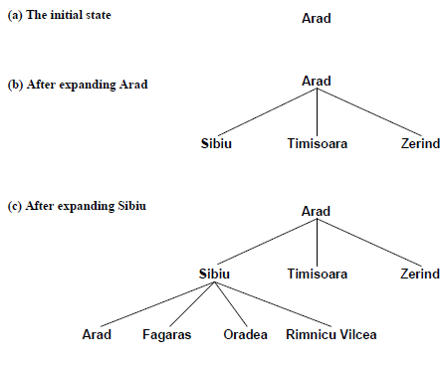
Search Algorithms Terminologies
Search tree
A tree representation of search problem is called Search tree.
The root of the search tree is the root node which is corresponding to the initial state.
Actions
It gives the
description of
all the available
actions to the agent.

Slide 12
Search Algorithms Terminologies
Transition model
A description of what each action do, can be represented as a transition model.
Path Cost
It is a function which assigns a numeric cost to each path.
Solution
It is an action sequence which leads from the start node to the goal node.
Optimal Solution
If a solution has the lowest cost among all solutions.

Slide 13
Properties of Search Algorithms
The output of a problem-solving algorithm is either failure or a solution. (Some algorithms might get stuck in an infinite loop and never return an output.)
There are four essential properties of search algorithms to compare the efficiency of these algorithms:

Slide 14
Properties of Search Algorithms
Completeness
A search algorithm is said to be complete if it guarantees to return a solution if at least any solution exists for any random input.
Optimality
If a solution found for an algorithm is guaranteed to be the best solution (lowest path cost) among all other solutions, then such a solution for is said to be an optimal solution.

Slide 15
Properties of Search Algorithms
Complexity
Time complexity is a measure of time for an algorithm to complete its task.
If the algorithm completes a task in a lesser amount of time, then it is an efficient one.
Space Complexity
It is the maximum storage space required at any point during the search, as the complexity of the problem..
These properties are also used
To
compare the efficiency of the different types of searching algorithms.

Slide 16
Process of Problem-Solving using Search Algorithms
The process of problem-solving using searching consists of the following steps.
Define the problem
Analyze the problem
Identification of possible solutions
Choosing the optimal solution
Implementation

Slide 17
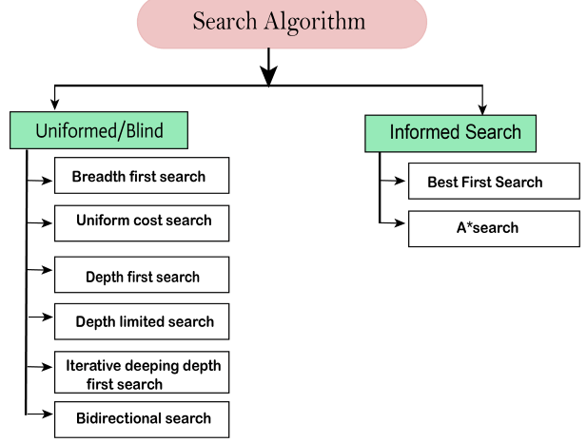
Types of Search Algorithms
Based on the search problems we can classify the search algorithms into uninformed (Blind search) search and informed search (Heuristic search) algorithms.

Slide 18
Uninformed/Blind Searching Techniques
The uninformed search algorithm does not have any domain knowledge such as closeness, location of the goal state, etc.
it behaves in a brute-force way
It only knows the information about how to traverse the given tree and how to find the goal state.
.It examines each node of the tree until it achieves the goal node.
This algorithm is also known as the Blind search algorithm or Brute -Force algorithm

Slide 19

Uninformed/Blind Searching Techniques
Search through the space of possible solutions
Use no knowledge about which path is likely to be best
Before actually doing something to solve a puzzle, an intelligent agent explores possibilities “in its head” Search = “mental exploration of possibilities”
Making a good decision requires exploring several possibilities
Execute the solution once it’s found

Slide 20
Uninformed/Blind Searching Techniques
Also called
Blind Search
Exhaustive Search
Brute-force Search
The term means that they have no additional information about states beyond that provided in the problem definition; i.e. do not guide the search with any additional information about the problem

Slide 21
Uninformed/Blind Searching Techniques
Following are uninformed searching techniques
Breadth-first search
Depth-first search
Uniform Cost
Depth-limited search
Iterative deepening depth-first search
Bidirectional

Slide 22
Uninformed/Blind Searching Techniques
Cost Variables
Time: number of nodes generated
Space: maximum number of nodes stored in memory
Branching factor: b Maximum number of successors of any node
Depth: d Depth of shallowest goal node
Path length: m
Maximum length of any path in the state space

Slide 23
Breadth-First Search
It uses First-in First-out (FIFO) strategy as it gives the shortest path to achieving the solution.
BFS is used where the given problem is very small and space complexity is not considered
Breadth-first search is a simple strategy in which
The root node is expanded first
Then all the successors of the root node are expanded next
Then their successors, and so on.

Slide 24
Breadth-First Search
In general, all the nodes are expanded at a given depth in the search tree before any nodes at the next level are expanded
It is called as the level by level traversal technique.
In this technique, all solutions for each node are found out. This guarantees the optimal solution.

Slide 25
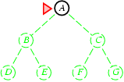
Breadth-First Search
Expand shallowest unexpanded node Implementation:
Fringe is a FIFO queue, i.e. New Successors go at end

Slide 26
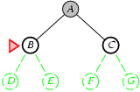
Breadth-First Search
Expand shallowest unexpanded node Implementation:
Fringe is a FIFO queue, i.e. New Successors go at end

Slide 27
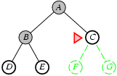
Breadth-First Search
Expand shallowest unexpanded node Implementation:
Fringe is a FIFO queue, i.e. New Successors go at end

Slide 28
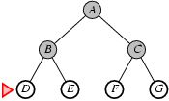
Breadth-First Search
Expand shallowest unexpanded node Implementation:
Fringe is a FIFO queue, i.e. New Successors go at end

Slide 29
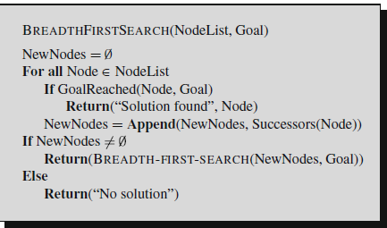
Breadth-First Search
Where the d= depth of shallowest solution and b is a node at every state.

Slide 30
Breadth-First Search
Complete? Yes (if b is finite)
Time? 1+b+b²+b³+… +b^{d} + b(b^{d}-1) = O(b^{d+1})
Space? O(b^{d+1}) (keeps every node in memory)
Optimal? Yes (if cost = 1 per step)
Space is the bigger problem (more than time)
Where the d= depth of shallowest solution and b is a node at every state.

Slide 31
Breadth-First Search
Advantages
The shortest number of steps is required to reach the goal node in the search tree
Provide a solution if any solution exists.
If there are more than one solutions for a given problem, then BFS will provide the minimal solution which requires the least number of steps.
Disadvantages
It requires lots of memory since each level of the tree must be saved into memory to expand the next level.
BFS needs lots of time if the solution is far away from the root node.

Slide 32
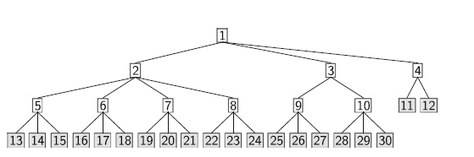
Breadth-First Search

Slide 33
Depth-First Search
Depth-first search is a recursive algorithm for traversing a tree or graph data structure.
Depth-first search always expands the deepest node in the current fringe of the search tree.
The search proceeds immediately to the deepest level of the search tree, where the nodes have no successors.
As those nodes are expanded, they are dropped from the fringe, so then the search "backs up" to the next shallowest node that still has unexplored successors
Depth-First Search traverses the edges twice and vertex only once along the path.
It is also called an edge-based method.````

Slide 34
Depth-First Search
DFS uses a stack data structure for its implementation.
The process of the DFS algorithm is similar to the BFS algorithm.

Slide 35
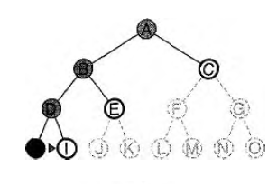
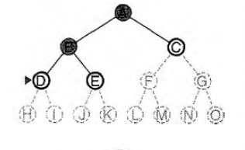
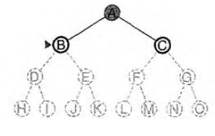
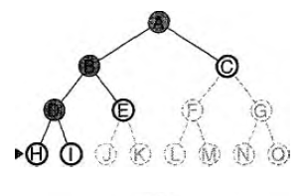
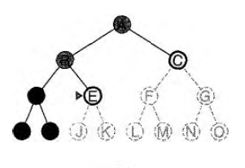
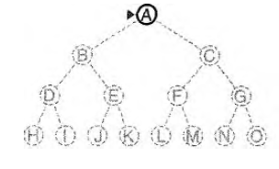
Depth-First Search

Slide 36
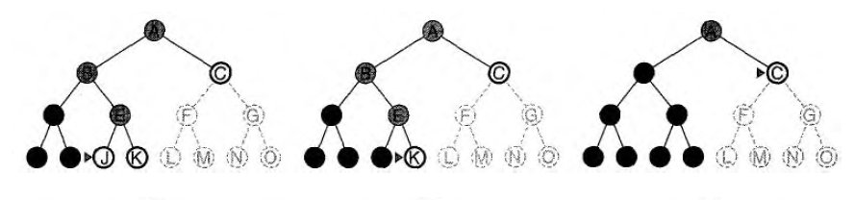
Depth-First Search

Slide 37
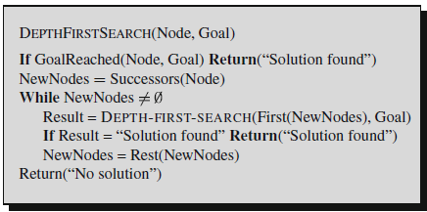
Depth-First Search
Where the d= depth of shallowest solution and b is a node at every state.

Slide 38
Depth-First Search
Completeness
DFS search algorithm is complete within finite state space as it will expand every node within a limited search tree.
Time Compleity
1+b+b²+b³+… +b^{d} + b(b^{d}-1) = O(b^{d+1})
Space? O(b^{d+1}) (keeps every node in memory)
Optimal? Yes (if cost = 1 per step)
Space is the bigger problem (more than time)
Where the d= depth of shallowest solution and b is a node at every state.

Slide 39
Depth-First Search
Advantages
DFS requires very less memory as it only needs to store a stack of the nodes on the path from root node to the current node.
It takes less time to reach to the goal node than BFS algorithm (if it traverses in the right path).
In the worst cases also, there is a chance of reaching the target using many paths to find goal state.
Disadvantages
There is the possibility that many states keep re-occurring, and there is no guarantee of finding the solution.
DFS algorithm goes for deep down searching and sometime it may go to the infinite loop.

Slide 40
Uniform Cost Search
Used to find a minimum cost traversal search for a graph tree to reach a path. It is one of the state space search algorithms.
In this algorithm at every state the path with the least cost is selected.
Used a priority queue to find the minimum cost of adjacent nodes.
It backtracks and finds a new solution for all possible ways to reach the destination. Then it chooses a minimum cost to traverse from root to destination.
It always compares the paths minimum costs for a graph/tree and chooses the optimal cost when the path that is explored cannot find good results.

Slide 41
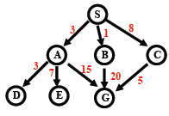
Uniform Cost Search
The Uniform Cost Search algorithm is also called Dijkstra’s single-source shortest path algorithm.
Example

Slide 42
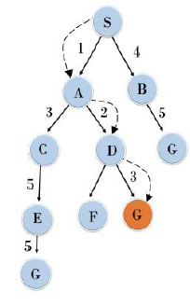
Uniform Cost Search
Example

Slide 43
Uniform Cost Search
Advantages
It finds the optimal solution by considering the minimum cost for each node.
It minimizes the space by finding minimum cost nodes.
It reduces the time complexity by choosing minimum nodes to explore.
Disadvantages
It finds many ways to get the minimum cost traversal from root to destination hence time complexity increases.
Its space complexity also increases when one path cannot find the optimal solution
If the path chosen cannot find the optimal solution it compares with the previous solution and takes a decision which makes space complexity and execution time more.

Slide 44
Depth Limited Search
DFS + Predetermined limit
It can solve the problem of infinite path in the Depth-first search.
The node at the depth limit will treat as it has no successor nodes further.
Impose a cut-off (e.g. n for searching a path of length n-1), expand nodes with max.
Depth first until cut-off depth is reached (LIFO strategy, since it is a variation of depth-first search).

Slide 45
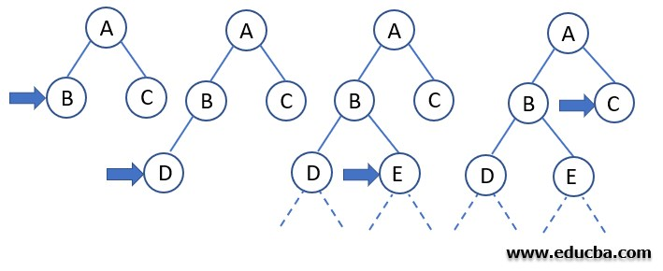

Depth Limited Search
Example

Slide 46
Iterative Deepening Search
Iterative-Deepening search is the combination of both the Depth-First Search and Breadth-First Search.
It performs a Depth-First Search level by level until the target node found in the state space search tree.
Here each level of depth search is considered as the iteration. therefore it is also called as the Iterative Deepening Depth First Search (IDDFS)

Slide 47
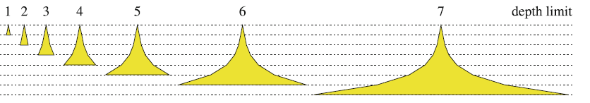
Iterative Deepening Search
Progressively increases the limit of the limited-depth depth first search
Starts with a depth limit of 1. If no solution is found, limit is raised by 1 and start searching from the beginning, and so on
Schematic representation of the development of the search tree in iterative deepening with limits from 1 to 7.

Slide 48
Iterative Deepening Search
It can guarantee to find an optimal solution along with the first generation of the path.
It terminates the search when the solution at depth d is found.
Since it uses both features it can traverse the graph with or without cycles.

Slide 49
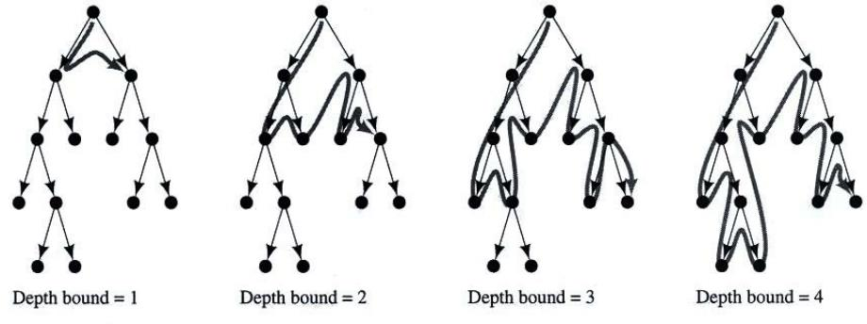
Iterative Deepening Search

Slide 50
Iterative Deeping Search
Advantages
Uses both a Depth-First Search and Breadth-First Search to find the minimum cost weighted edge path.
It uses a new threshold to find the minimum cost of all nodes generated by cutting off the previous iterations.
It uses the Depth-First Search to optimize the space.
Disadvantages
Recursively performs the previous phases hence it requires more space.
It uses a lot of time to perform iterations before the one to find a solution.
Time complexity increases in performing several iterations that cannot produce the goal state path

Slide 51
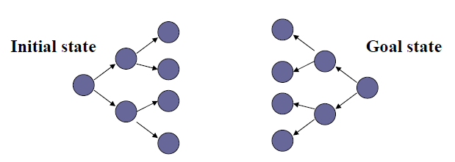
Bi-directional Search
In some search problems we want to find the path from the initial state to the unique goal state (e.g. traveler problem)
Search both from the initial state and the goal state;
Use inverse operators for the goal-directed search.
Stops when the two searches meet

Slide 52
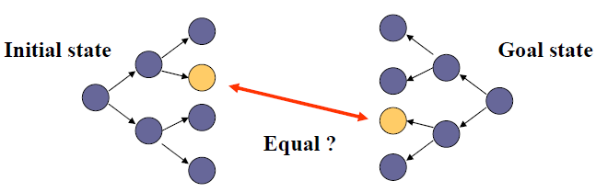
Bi-directional Search
It is a brute force algorithm that requires an initial state and a clear description of each state, goal state.
Forward pointer moves from source and explores the nodes and the backward pointer moves from goal state until the forward pointer meets.
It concatenates both the pointers to find the optimal path.

Slide 53
Bi-directional Search
Either forward or backward pointer can use Breadth-First Search algorithm to meet at a particular node.
When does it help?
It cuts the size of the search tree by half.
What is necessary?
Merge the solutions.

Slide 54
Bi-directional Search
Advantages
Reduces the time complexity because it only searches half of the tree.
Requires less space.
Guaranteed to find an optimal solution.
Reduces traversing the unexplored nodes using breadth first search.

Slide 55
Bi-directional Search
Disadvantages
At least one pointer uses a Breadth-First Search algorithm to traverse half of the tree hence it sometimes requires space.
If the breadth first search on either forward pointer or backward pointer fails the space complexity increases.
Time complexity increases while breadth first search using with greater depths.

Slide 56
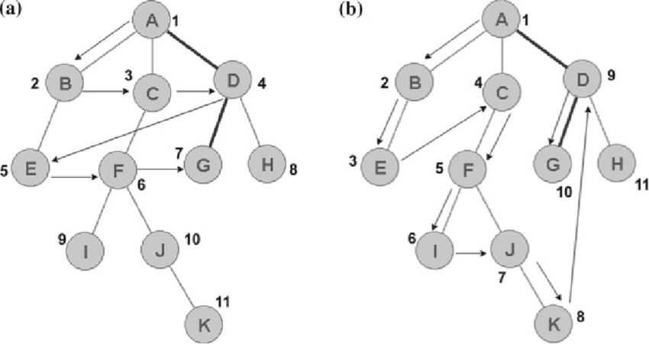
Bi-directional Search
Example

